Slide 1
INTRODUCTION TO MODULAR SYNTHESIS
Signal Flux x Pioneer Works
September 2019
Week 2: Creating Events

Slide 2
Agenda
Review
Creating an Event
Gates and Triggers
Clocks
Envelopes
Creating a Melody
Scales, Intervals, and Pitch
Volt/Octave, Sequencers, and Quantizers
Mixers: CV and Audio
Break
Lab Time
Patch Analysis

Slide 3
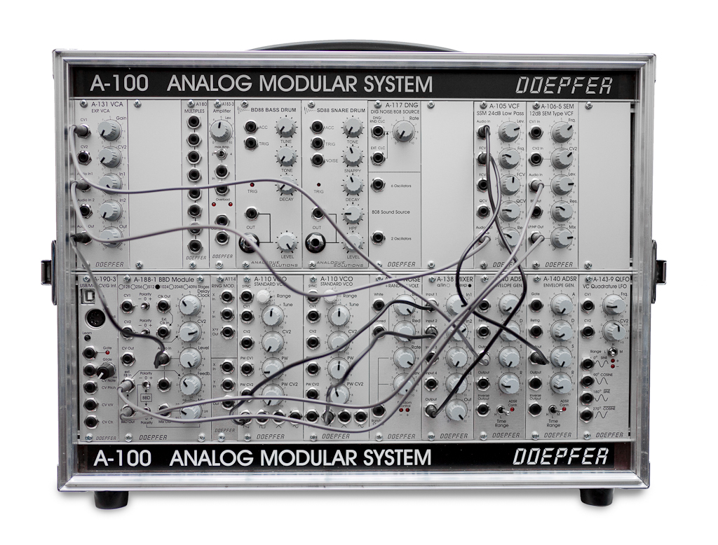
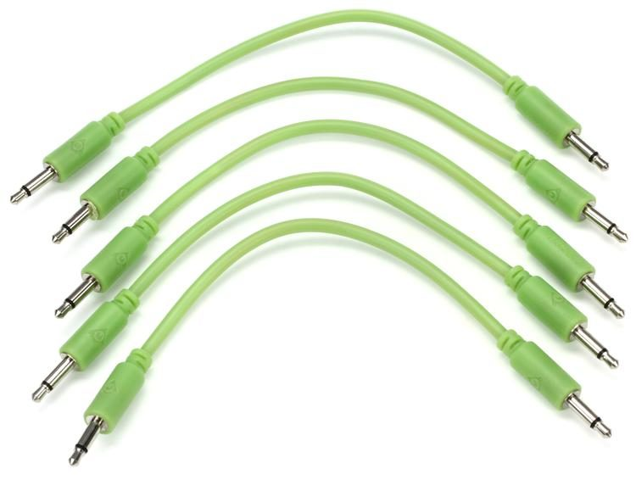
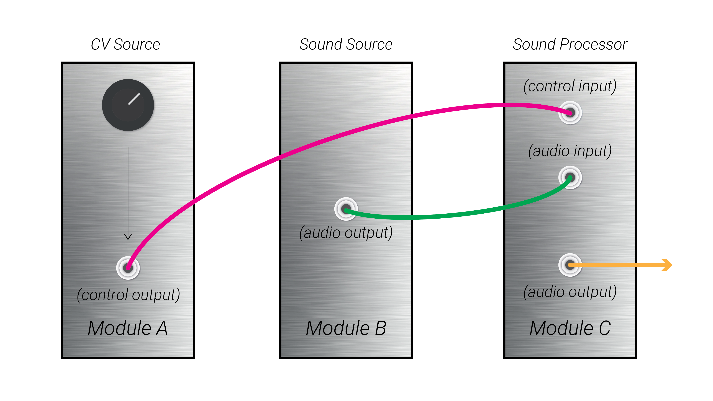
Modular Thinking: Patching
Cables carry signals from the output of one module to the input of another module
Signals may be audio for processing
Signals may be control voltage used to modify parameters on another module
Composing or improvising with a modular synthesizer is the act of creating and interacting with patches

Slide 4
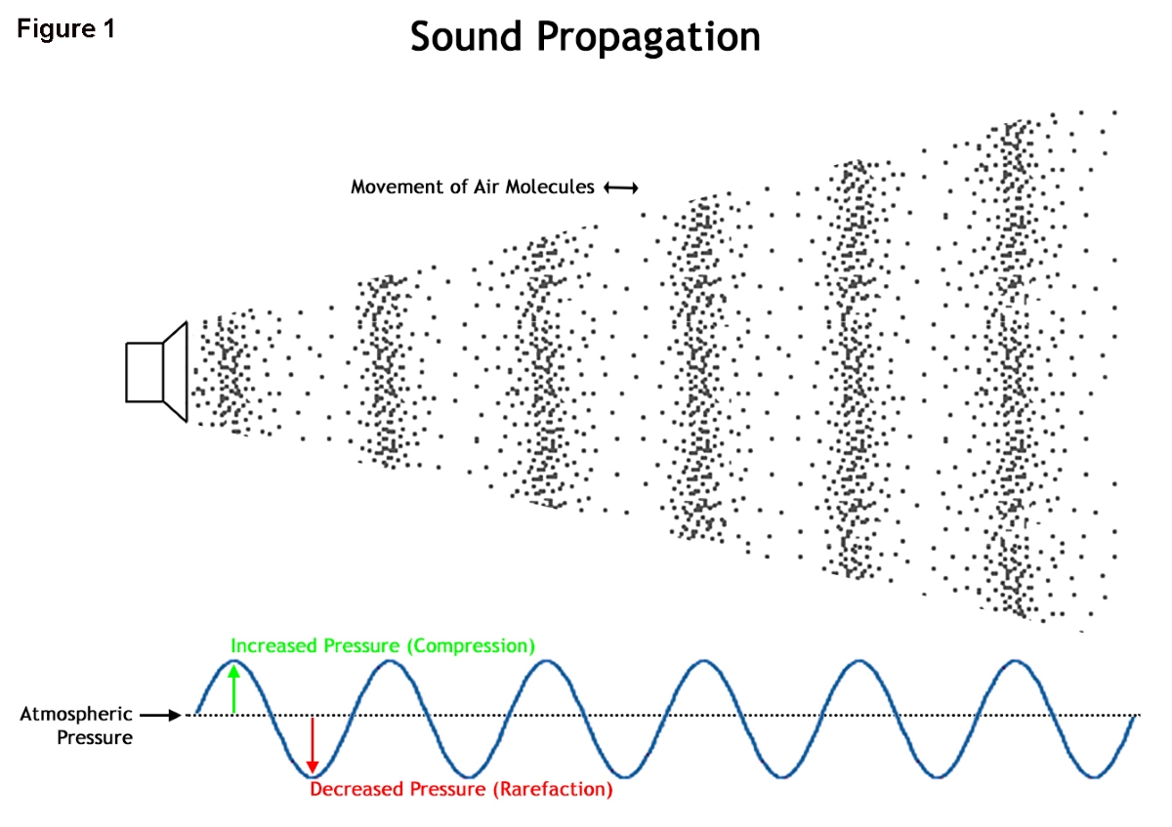
What is sound?
The phenomenon of Sound is created by air pressure waves reaching our ears.
Notes:
ASK THE AUDIENCE:
What is sound/

Slide 5
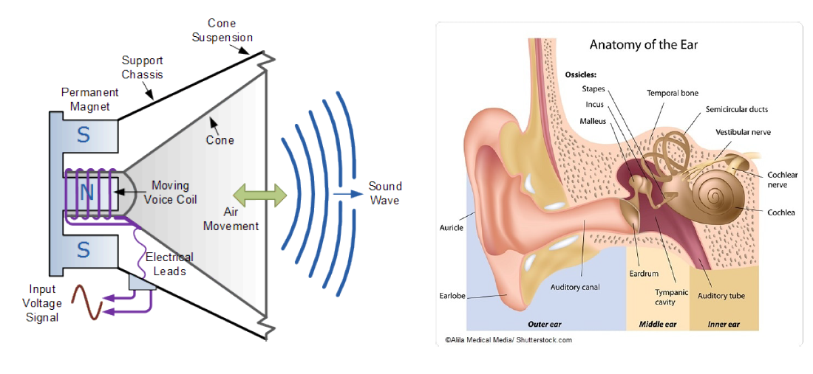
The Physics of Sound
Synthesizers generate the voltage to push the speaker cone, and thus create sound!
Electrical voltages are used to push the speaker cone back and forth.
Speaker cones push air back and forth, creating air pressure waves.
Air pressure waves reach the ear and are heard as sound.

Slide 6
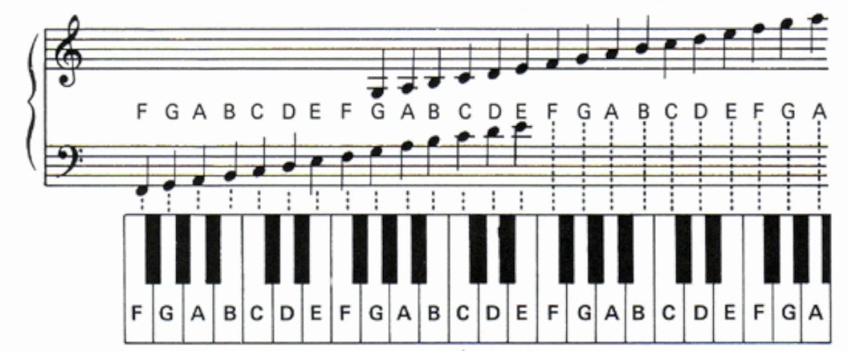
The Parameterization of Sound
Pitch:
How high or low a sound is
Melodies are made out of sequences of different pitches
Harmonies and chords are composed of multiple voices producing different pitches that sound pleasing together
Notes:
ASK THE AUDIENCE:
What are the different parameters of sound?
Demo two different pitches, or maybe a sequence of pitches, even a chord from JF maybe

Slide 7
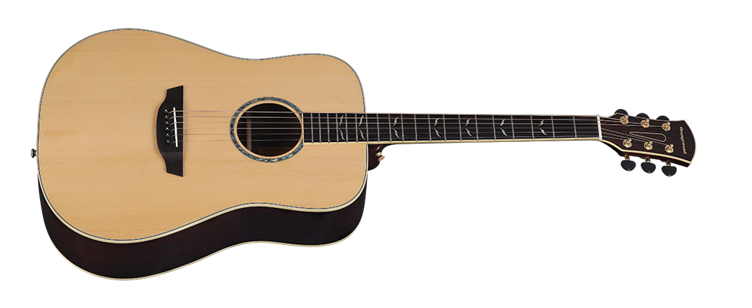
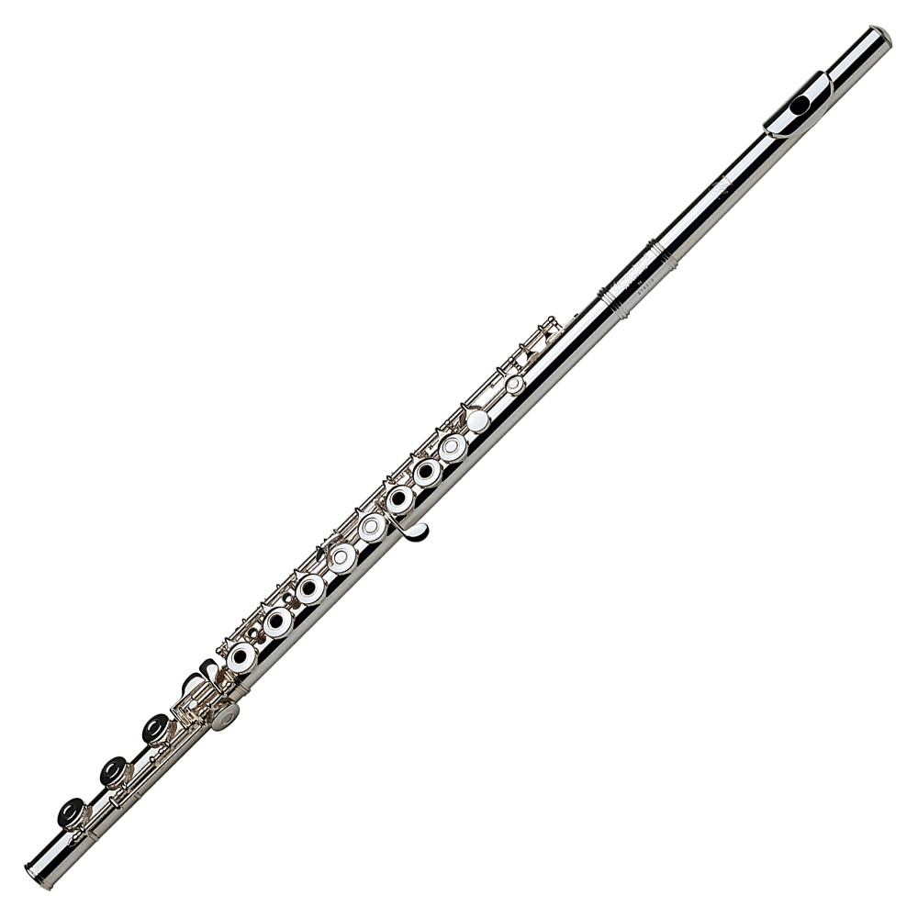
The Parameterization of Sound
Timbre:
The “character” of a sound;
The difference between the same pitch played by two different instruments is their timbre
Notes:
Play e.g. a sawtooth wave vs a sine wave

Slide 8

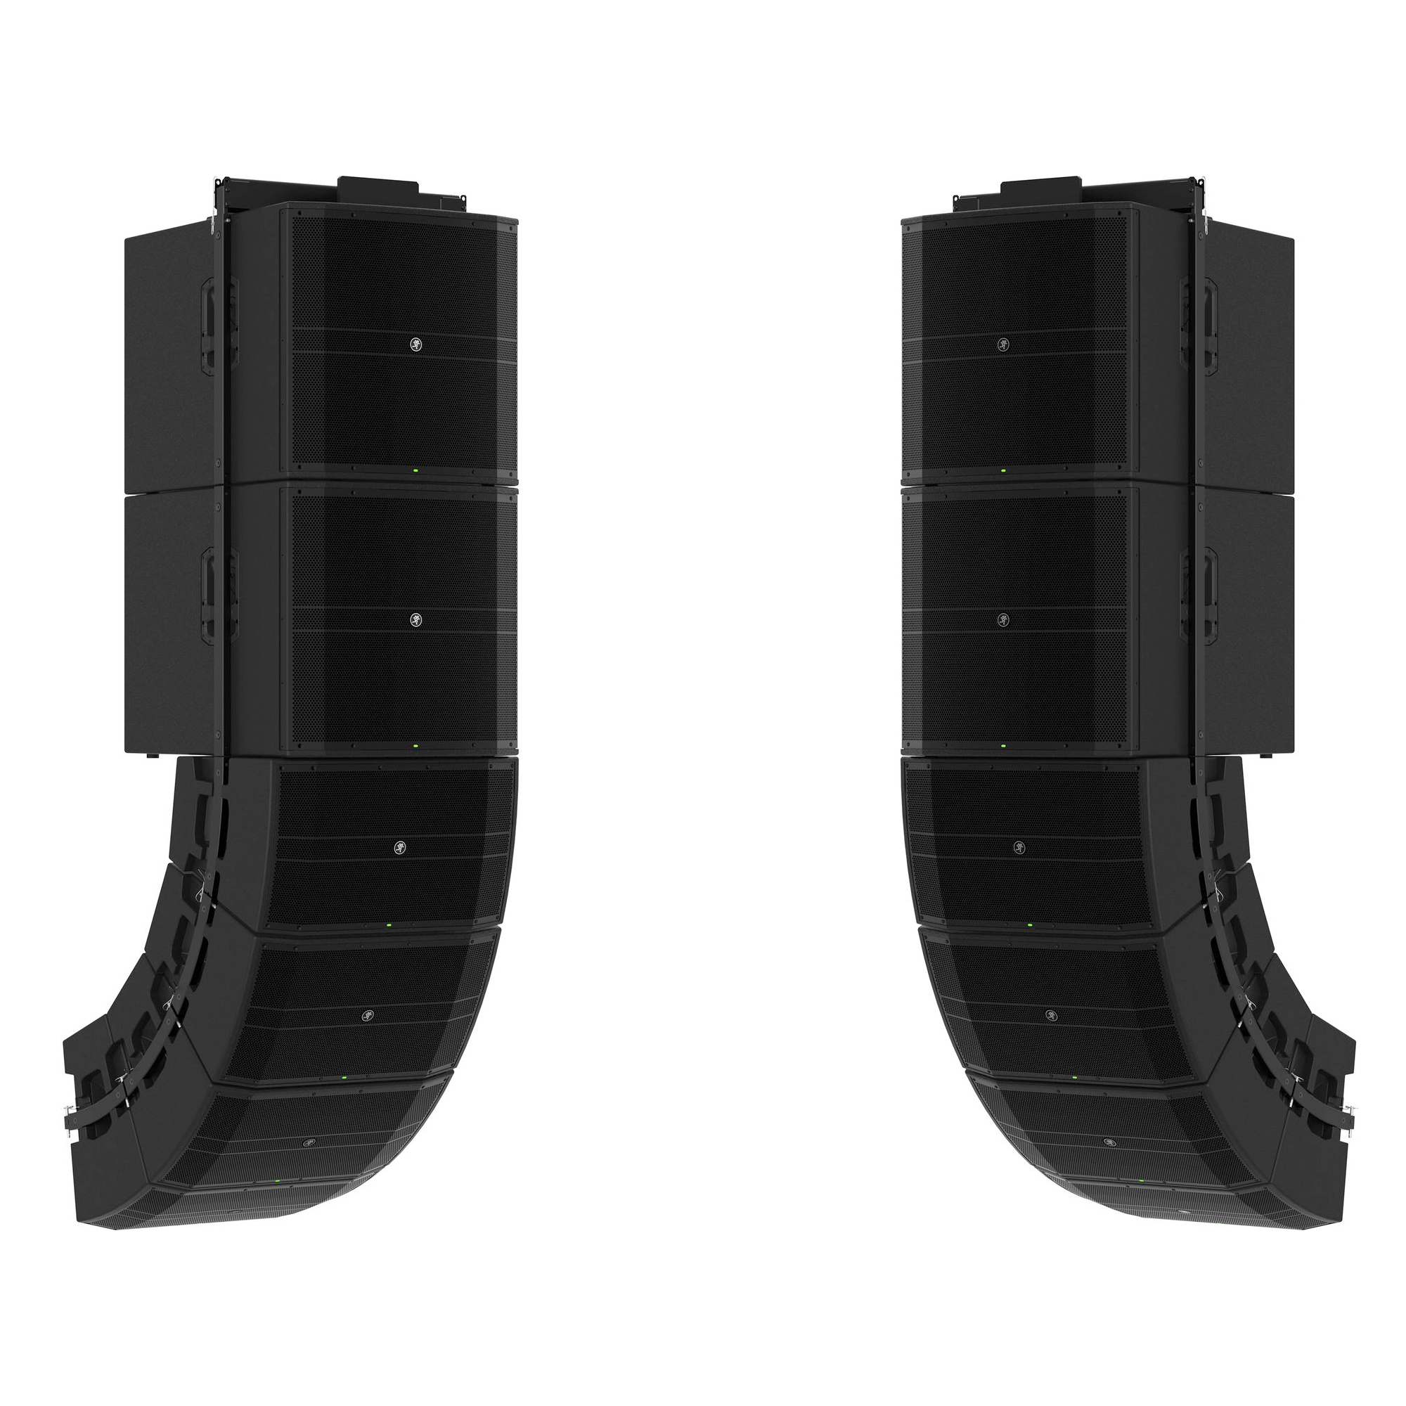
The Parameterization of Sound
Loudness:
The “intensity” of a sound
Greater sound pressure waves creates more intense ear drum movement, and a “louder” sound
Earbuds can produce sound waves only at a very quiet level, while a line array can play back the same sounds at an enormously louder level
Notes:
Change the volume of a sound (maybe once with an OSC, and once with Radio Music)

Slide 9
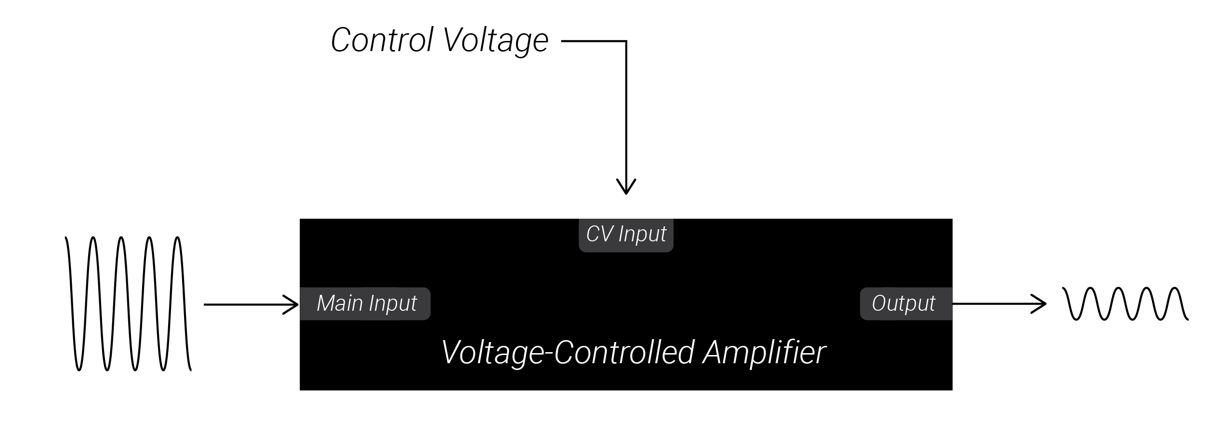
The Parameterization of Sound
Control Voltage/Modulation:
Using a slowly changing or constant signal from one module to change the parameters of another module
Notes:
Demonstrate an LFO, a sequence, and an envelope, maybe do 2-3 examples with an oscillator and one example with radio music.

Slide 10
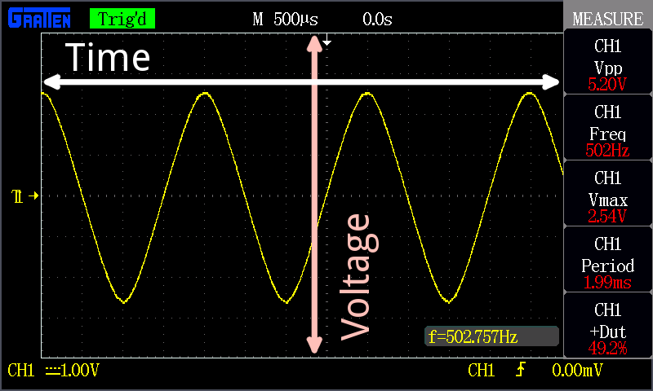
Oscillscopes, Voltage & Signals
Electrical signals are measured in voltage.
Magnitude corresponds to how large the voltage is (i.e. how far from 0V it is).
Polarity means whether the voltage is positive or negative.
Oscilloscopes show how signals change over time.

Slide 11
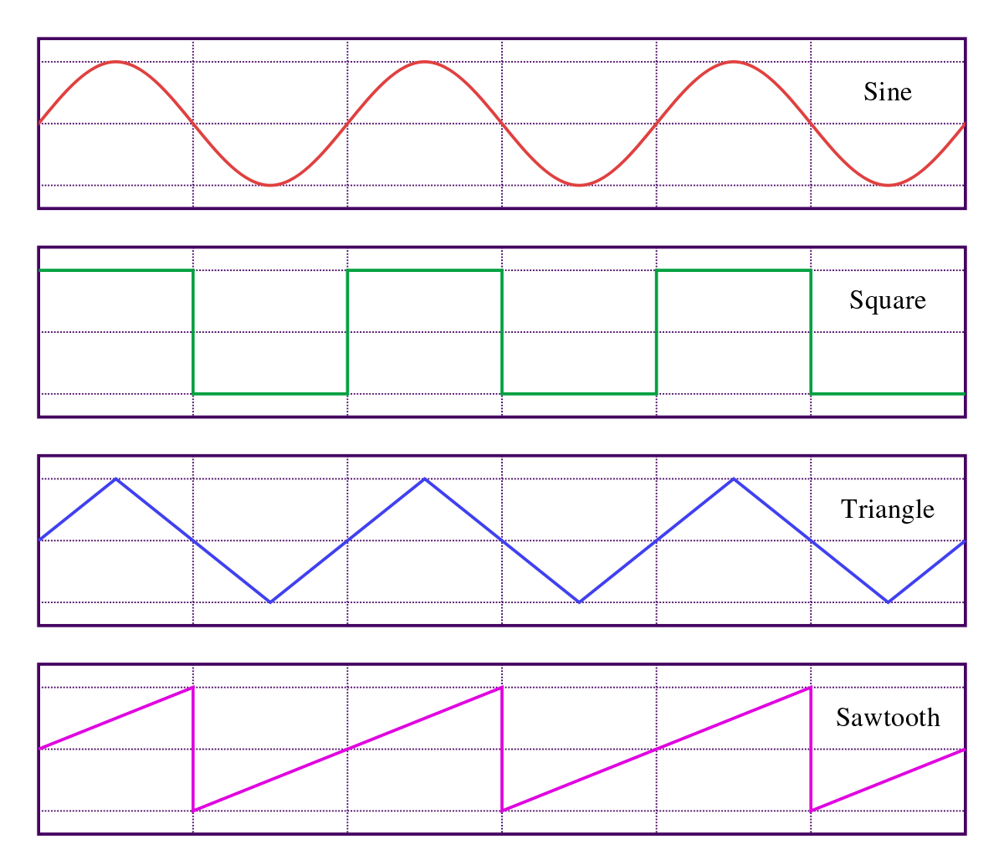
Oscillators
Oscillators create voltages which moves up and down in a pattern.
The shape of the repeating pattern is known as the “waveshape.”

Slide 12
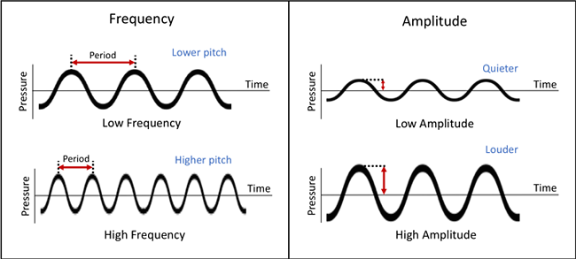
Oscillators
Period: the time it takes to complete one cycle of the pattern.
Frequency: the number of cycles completed per second, and is measured in Hertz (Hz)
Hertz (Hz): 1Hz = 1 cycle completed per second
If the frequency is greater than 20Hz, the oscillating voltage can be used to drive a speaker cone back and forth creating pitched sound waves. Higher frequencies correspond to higher pitches.

Slide 13
Oscillators
Amplitude: the difference between the largest (peak) and lowest (trough) voltage the oscillation reaches.
Peak-to-peak voltage (Vpp): Voltage difference between peak and trough
For audio-rate oscillations, the amplitude of the oscillation corresponds to its loudness: greater amplitude means louder sound.

Slide 14
Oscillators
Waveshape: the pattern an oscillator follows as it rises and falls
The waveshape of an audio-rate oscillator determines its timbre.
Sine waves are the “purest”, simplest sound.

Slide 15
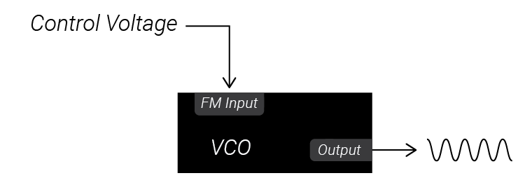
VCOs & LFOs
Voltage-controlled Oscillators (VCOs) are oscillators whose frequency can be controlled by external control voltage.
Low-Frequency Oscillators create oscillations which are too slow to be used as sound but can be used instead to controls parameters of another module, like the frequency of another VCO.
Frequency input jacks are often labeled “FM Input” for “frequency modulation.”

Slide 16
Attenuators, Inverters & Attenuverters
Attenuator: Changes the amplitude of an incoming signal without changing the shape of it in time. Vertically stretches/shrinks a voltage
Inverter: Flips the polarity of an incoming voltage but leaves the magnitude unaffected
Attenuverters: Similar to an attenuator, but it can also invert voltages before attenuating them.
Attenuators and Attenuverters generally scale the incoming voltage proportionally to the knob position. This allows us to control the depth of modulation by a given control voltage signal.

Slide 17
VCAs
Voltage-Controlled Amplifiers: Similar to attenuators, but instead of using a knob to set the attenuation, a VCA checks its control voltage input to set the attenuation of another incoming signal. The higher the control voltage input, the greater the amplitude of the signal output.
VCAs can be used to control the volume of an audio signal.
VCAs can also be used to control the modulation depth of another CV signal.

Slide 18

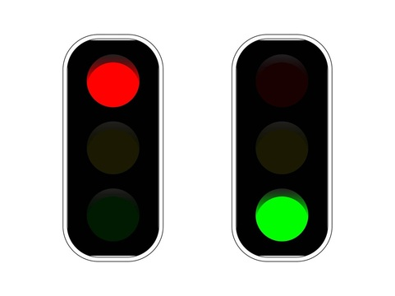
Gates & Triggers
Gates and Triggers are special signals in the modular world. Instead of directly modulating a parameter, they tell other modules to start and stop actions.
- Triggers can be thought of like the starting signal for a race. The trigger is an impulse which makes an event begin; the event then goes to completion.
- Gates can be thought of like stoplights. An action begins and continues as long as the gate is held high (green light), but stops as soon as the gate goes low (red light).

Slide 19
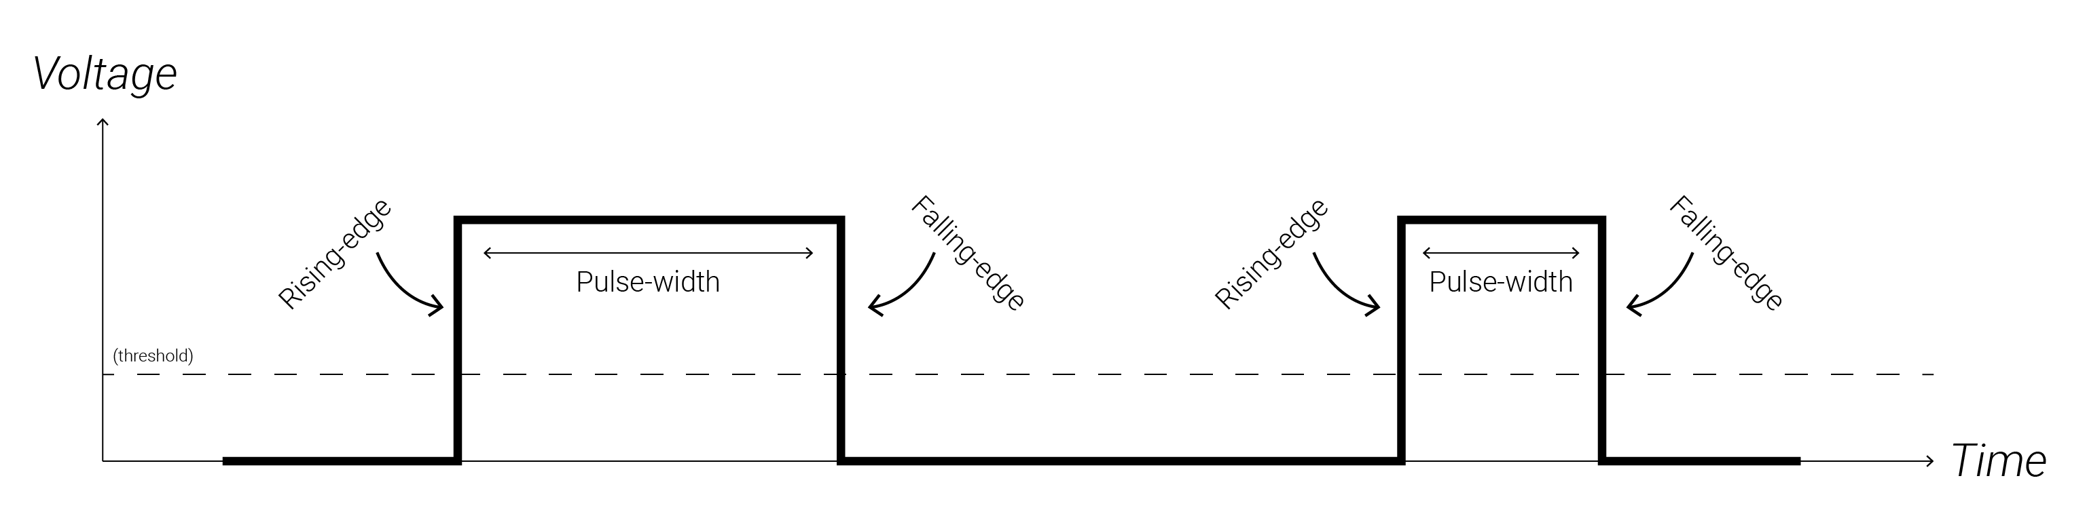
Gates & Triggers

Slide 20
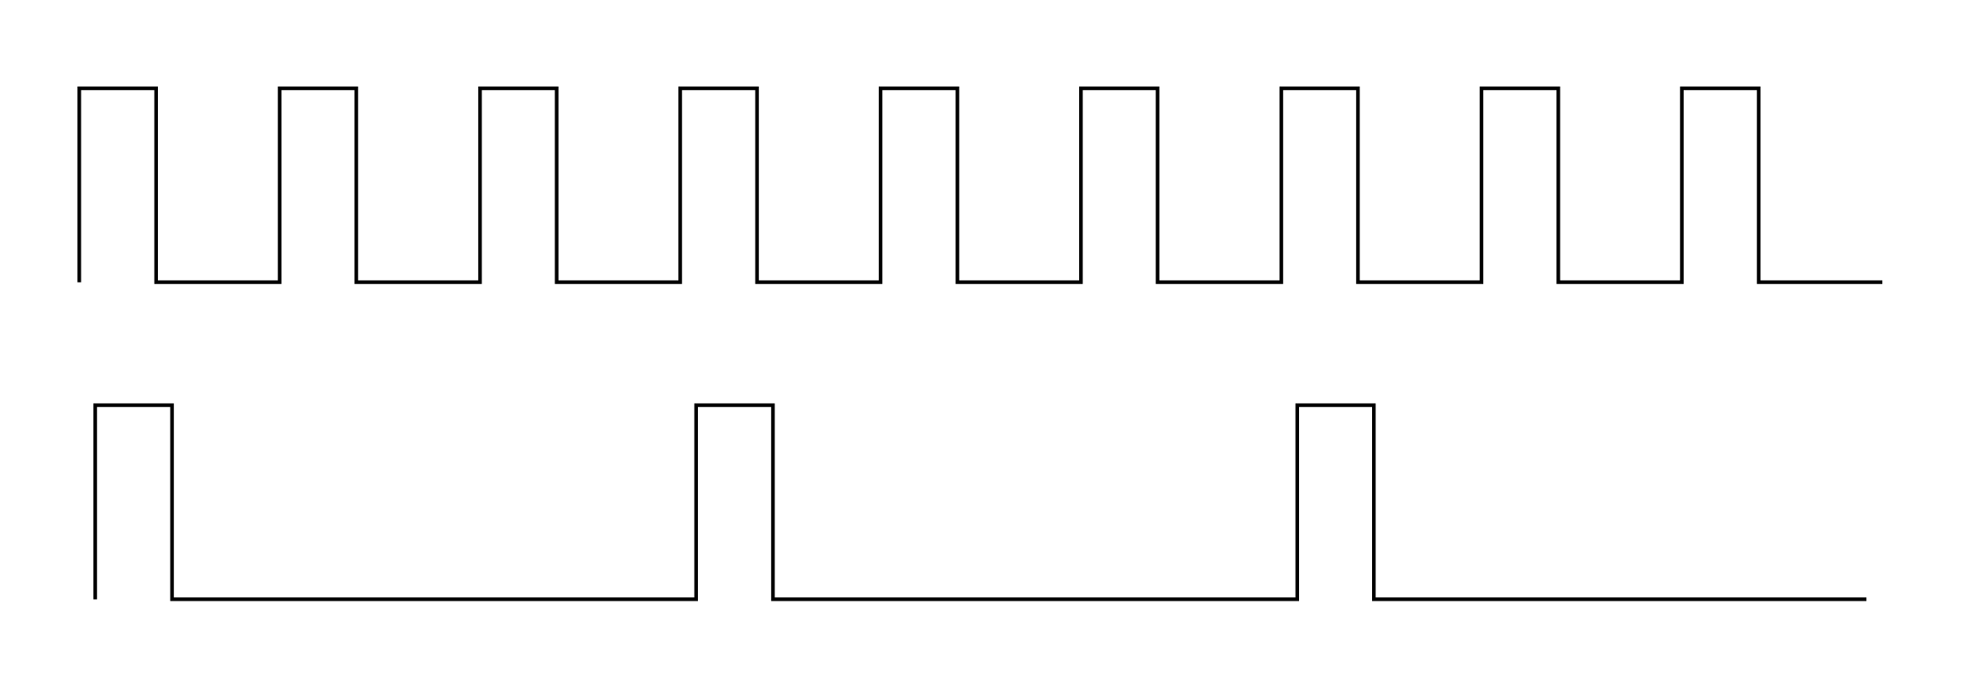
Clocks
Clocks are steady streams of gates (or triggers) that are generated at a constant rate.
Clock Modulation is the act of deriving a new rhythm of gate pulses based off a constant stream of clock pulses.
A single clock source is often used to synchronize many modules together so that actions all occur simultaneously.

Slide 21
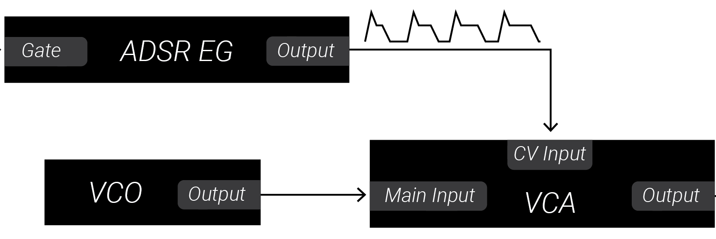
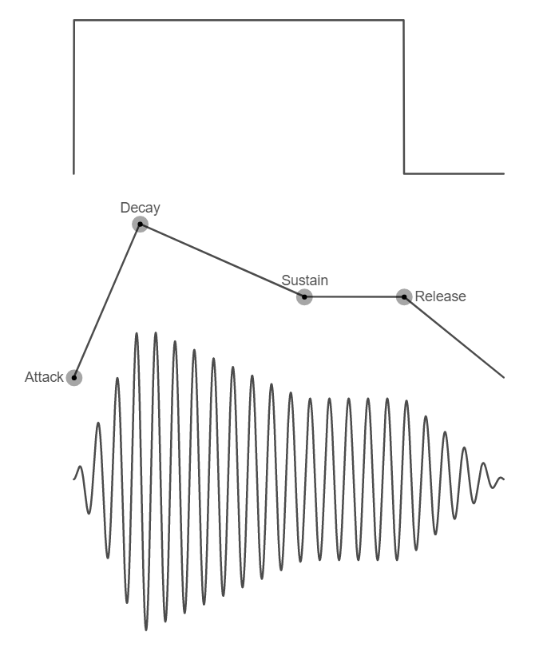
EGs
Envelope Generators (or EGs) create a voltage which rises and falls in response to a trigger or gate. EGs are useful for creating control voltage signals which have a beginning, middle, and end so that you can create distinct musical events.
EGs are often used to control a VCA processing a sound source, as depicted in the adjacent graph. This gives the sound source an “amplitude envelope” which can be heard as the sound source getting louder and quieter.

Slide 22
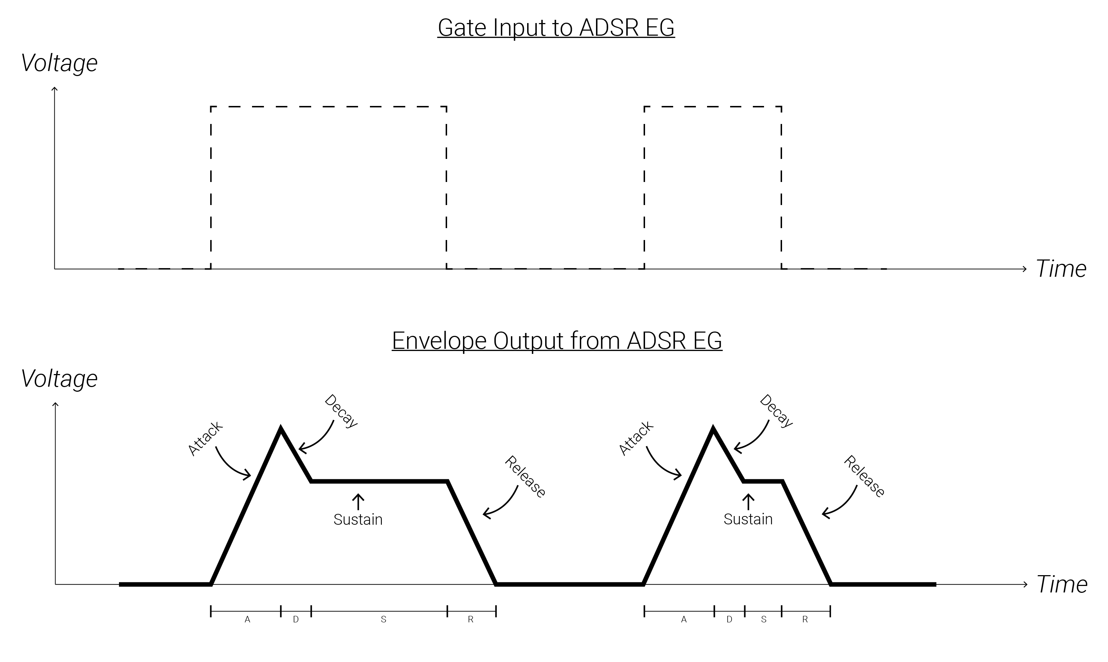
ADSR EGs
When an ADSR EG receives a gate, it begins an envelope.
Attack: the initial portion of an envelope where the envelope ramps from its resting voltage (0V) to its maximum voltage.
Decay: the envelope falls from its maximum to its sustain level.
Sustain: the envelope holds at the sustain level as long as the gate is still high.
Release: the envelope falls from its sustain level to its resting level (0V).
ADSR Demo

Slide 23
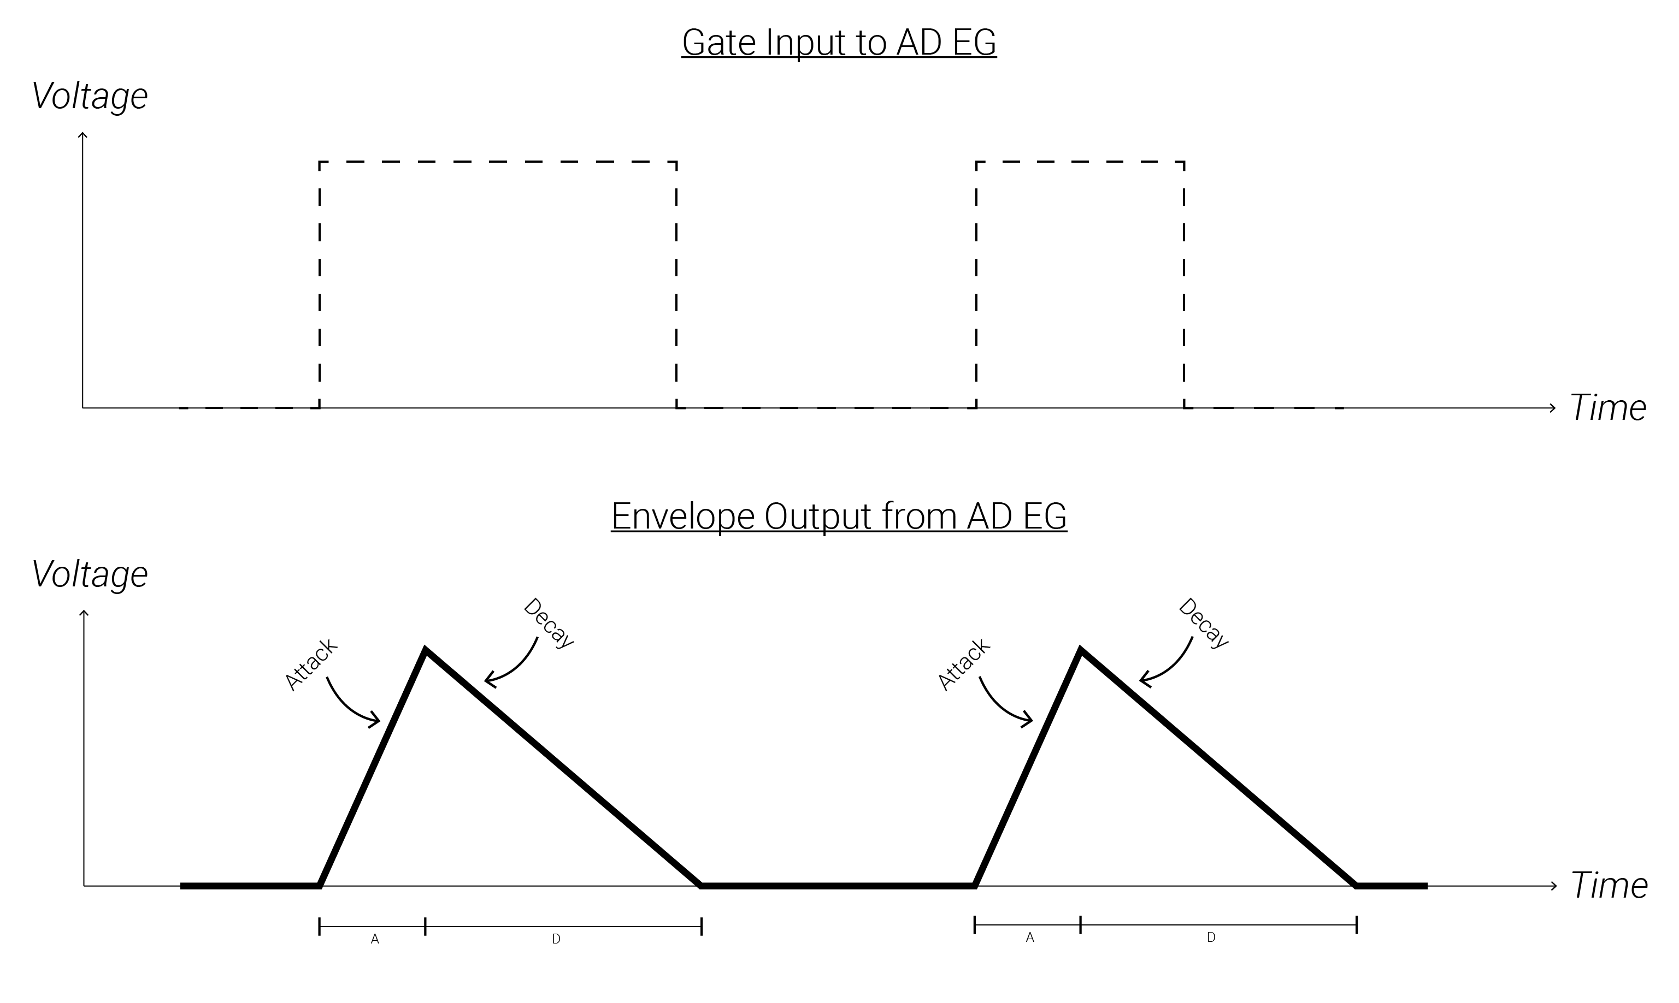
AD EGs
AD EGs are like ADSRs, except they do not respond to the pulse-width of a gate. Instead, they only treat input gates as triggers.

Slide 24
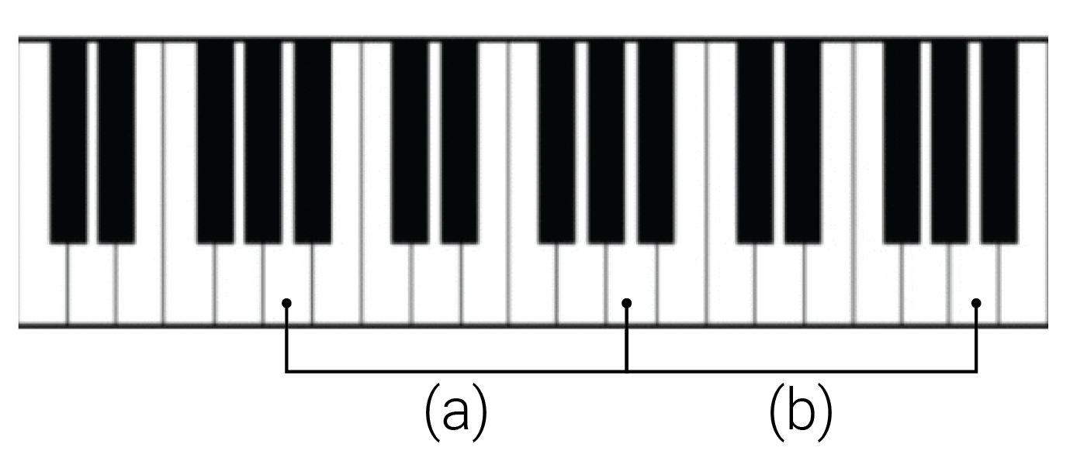
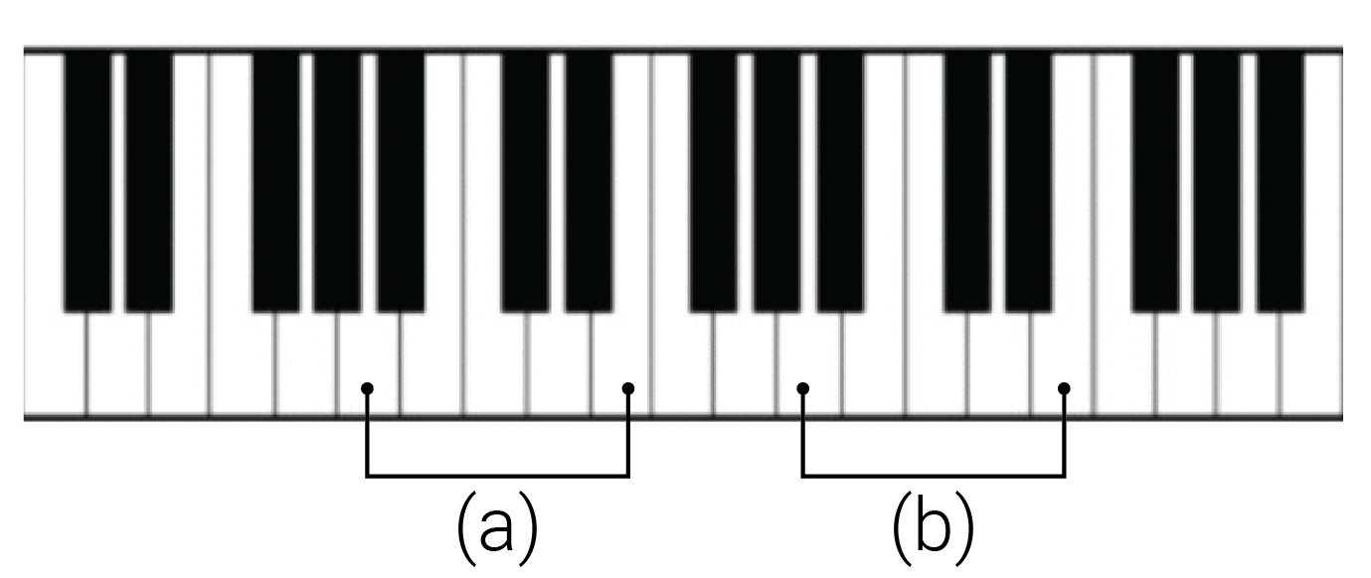
Intervals
Interval: the “distance” between two pitches (aka frequencies); not the absolute difference of the frequencies, but rather the ratio of the frequencies.
Octave: a 1:2 ratio between frequencies, e.g. 100Hz and 200Hz
Pitch class: A group of pitches whose ratios form powers of 2, e.g. 100Hz, 200Hz, 400Hz, 800Hz (i.e. chains of octave intervals).
Pitches in the same pitch class are said to be the same “note” but in different “octaves.”
Interval (a)
- Octave
- 220Hz to 440Hz
- 1:2
Interval (b)
- Octave
- 440Hz to 880Hz
- 1:2
Interval (a)
- Perfect 5th
- 220Hz to 330Hz
- 1:1.5
Interval (b)
- Perfect 5th
- 440Hz to 660Hz
- 1:1.5

Slide 25
V/Oct
Initial | V/Oct | Ratio | Final
100Hz | 0V | 1:1 | 100Hz
100Hz | +1V | 1:2 | 200Hz
100Hz | +2V | 1:4 | 400Hz
100Hz | +3V | 1:8 | 800Hz
100Hz | -1V | 2:1 | 50Hz
Volt-per-Octave (V/oct) is a special tuning system used for precisely changing oscillators frequencies.
It allows you to move oscillators up and down by exact intervals.
Every 1V increase at an oscillator’s V/Oct input results in the oscillator doubling its frequency – i.e. 1V increases moves it up an octave.
For those with a western music notation background a semitone would then be a 1/12V = 0.083V increase.
Initial | V/Oct | Ratio | Final
60Hz | 0V | 1:1 | 60Hz
60Hz | +1V | 1:2 | 120Hz
60Hz | +2V | 1:4 | 240Hz
60Hz | +3V | 1:8 | 480Hz
60Hz | -1V | 2:1 | 30Hz

Slide 26
Scales
A scale is a collection of intervals (usually less than an octave) to be paired with a root or tonic note; the collection is chosen to be somehow musically or sonically interesting.
Since scales are just collections of intervals, a scale can even be expressed in terms of V/Oct voltage levels.
Once a root note is chosen, the intervals in the scale define a collection of pitches above the root note (and all the other pitches within the same pitch classes).
Scale 1 = {root, major 2nd, major 3rd, 4th, 5th, major 6th, major 7th}
Scale 2 = {1x, 1.125x, 1.2x, 1.33x, 1.5x, 1.66x, 1.8x}
Scale 3 = {shadja, rishabh, gandhar, madhyam, pancham, dhaivat, nishad}
Scale 4 = {do, re, mi, fa, so, la, ti}
Scale 5 = {0V, +0.167V, +0.333V, +0.417V, +0.5833V, +0.75V, +0.833V}

Slide 27
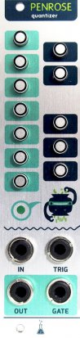
Quantizers
Root | Maj. 2nd | Maj. 3rd | 4th | 5th | Maj. 6th | Maj. 7th
0 st | 2 st | 4 st | 5 st | 7 st | 9 st | 11 st
1:2^{0/12} | 1:2^{2/12} | 1:2^{4/12} | 1:2^{5/12} | 1:2^{7/12} | 1:2^{9/12} | 1:2^{11/12}
0/12 V | 2/12 V | 4/12 V | 5/12 V | 7/12 V | 9/12 V | 11/12 V
0V | 0.167V | 0.333V | 0.417V | 0.583V | 0.750V | 0.917V
A quantizer allows the user to specify a scale (aka a collection of allowed intervals) and transform an input voltage into the closest voltage which corresponds to a V/Oct interval from the specified scale.
It internally creates a table of voltages corresponding to the V/Oct levels for the scale.
It compares an input signal to the table and outputs the closest voltage in the table.
All the octaves of each interval are also included in the table of allowed voltages.
Input | Output | Interval
0.3V | 0.333V | Maj. 3rd
0.7V | 0.750V | Maj. 6th
0.6V | 0.583V | 5th
1.3V | 1.333V | Maj. 3rd+Octave

Slide 28
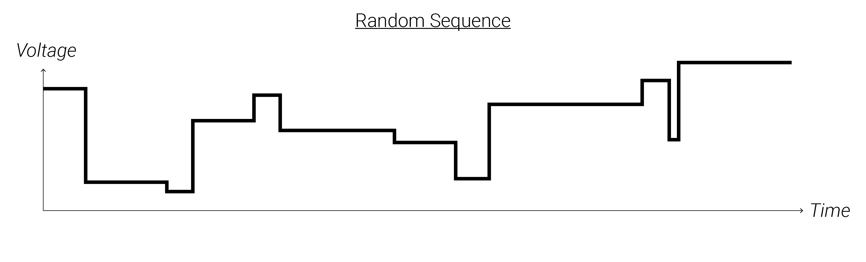
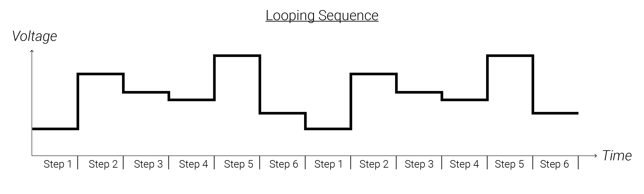
Sequences
A sequence is a control voltage signal which steps through different voltage levels. A sequence stays at each step's voltage for some amount of time before advancing to the next step.
When it changes steps, it jumps instantaneously from the current step's voltage to the next step's voltage.
A rhythmic stream of triggers or a clock source is usually needed to advance a sequencer from one step to the next, though many times sequencers will have built in clocks.

Slide 29
Mixers
Mixers mathematically add two signals together – the output is always the sum of the input voltages.
For CV signals, this allows you to combine multiple different modulation sources together to modulate a single target parameter.
For audio signals, this allows you to layer sound or process multiple sounds together in a single chain as a group (or bus).
Some mixers may include attenuators (or even VCAs) to control the level of each signal.
Mixing Demo

Slide 30
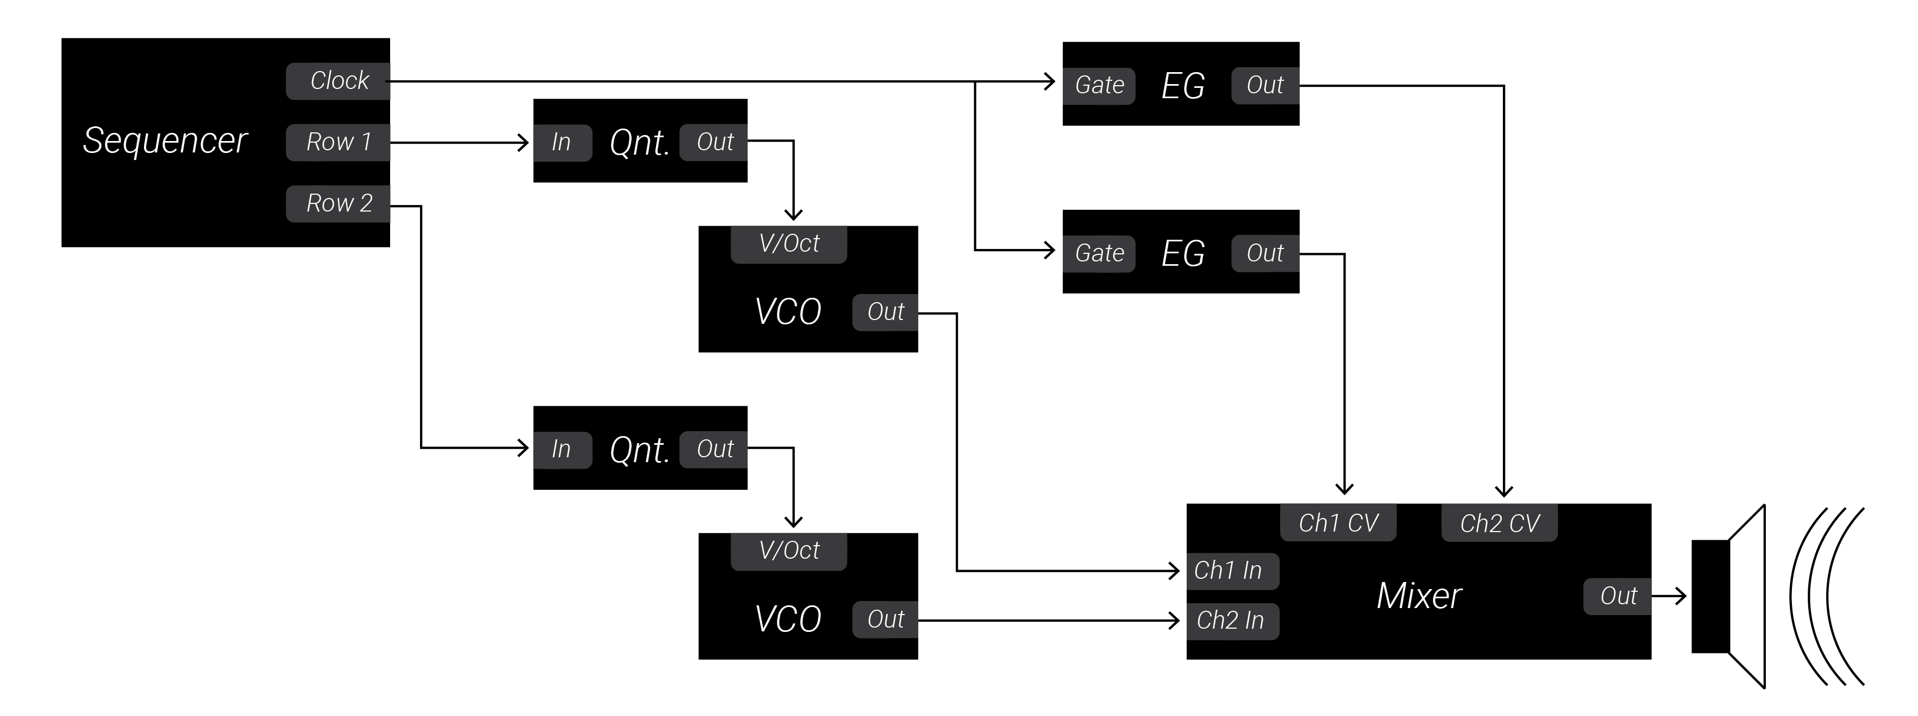
Patch Analysis
Audio Path
Sound Sources
Sound Processors/Effects
Mixers
Modulation Sources
LFOs
Sequencers, Sample and Hold
Quantizers
Envelopes
Random/Chance
Slews
Clocks
Clock Sources
Clock Modulation
Leaders & Followers

